Slide 1


SHORT TIME JOB PORTAL
NAME | ID
RAHMAN MD AKIB UR | 19-40279-1
DEB KABYO | 19-40242-1
DAS RAHUL | 19-40241-1
BISWAS PROSENJIT | 19-39637-1
GROUP :02

Slide 2



OBJECTIVES
1.INTRODUCTION
2.REQUIREMENT ANALYSIS
3.USER STORIES
4.USE CASE DIAGRAM
5.USER DESIGN INTERFACE
6.ACTIVITY DIAGRAM
7.JIRA TOOLS
8.GITHUB TOOLS
9.CLASS DIAGRAM
10.PROJECT SCHEDULING
11.PROJECT BUDJETING
12.CONCLUSION

Slide 3

INTRODUCTION
A part-time job is one of the best choices for students to earn their pocket money. The trend of doing part-time jobs for earning is gradually becoming popular among students in Bangladesh. Working part-time, students can bear the educational expenses & support their family, apart from just managing pocket money. Moreover, while doing part-time jobs, students can learn essential skills like discipline, team management, teamwork & acquire knowledge as well. But in our country there is no specific job portal for part-time jobs. So, by this system we can make the connectivity between part-time job seeker and employer. Where employer can post for the job and employee can find the job easily.

Slide 4

REQUIREMENT ANALYSIS
Q1. Does the project have a clear target market or audience?
Yes, Our project have a clear target audience. There are many types of students who are interested in studying as well as part time jobs and there are many institution who needs short time employee for their business.
So, our targeted audience is basically those students who are expecting a short time job and those employers who want to hire short time employees .

Slide 5




REQUIREMENT ANALYSIS
Q2. Does the team demonstrate a thorough understanding of the need, problem or opportunity, including evidence of research into the need, problem or opportunity?
For doing part time job students needs agency or portal Since the students do not have any portal for finding part time job for our portal they easily find their desired job and the institution can also find their employees.
Difficulty in measuring working hours and performance of short-timers.
There is no longer any job security or employee benefit such as health insurance, retirement benefits and others.
Job seekers & job providers will be able to meet their desired needs through this portal without any hassle of advertisement and this portal will also contribute to the economic sector.
https://www.academia.edu/33747031/Research_report_on_Why_Students_prefer_Part_time_job_besides_Study_

Slide 6
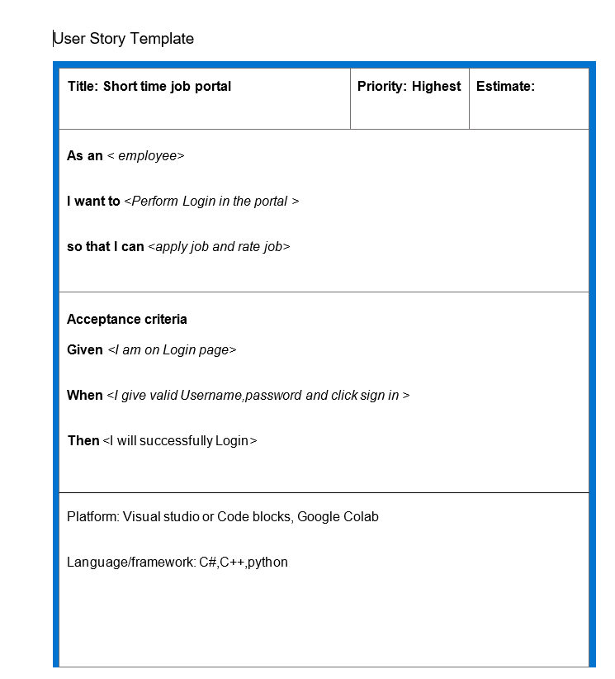
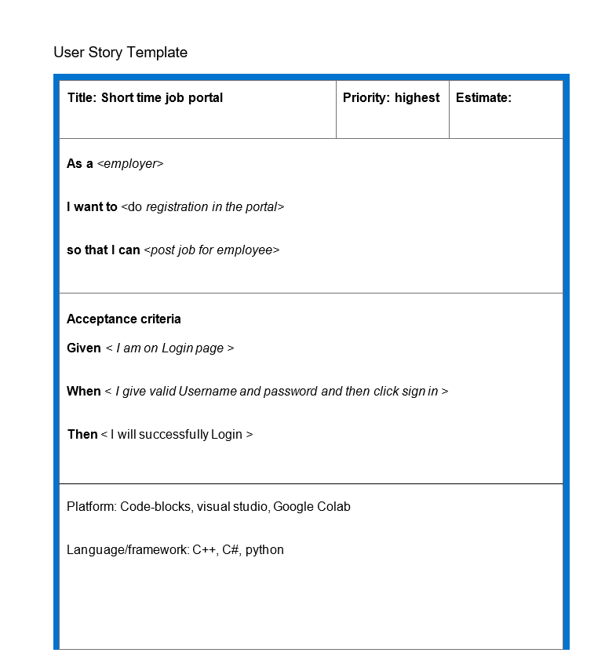
USER STORIES

Slide 7
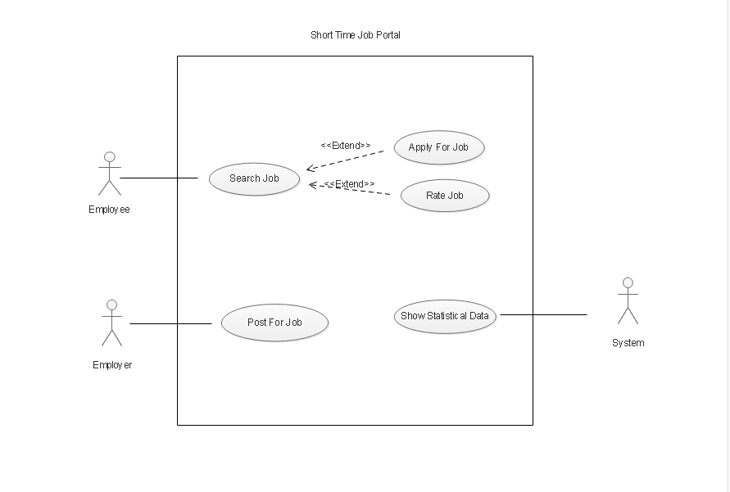
USE CASE DIAGRAM

Slide 8
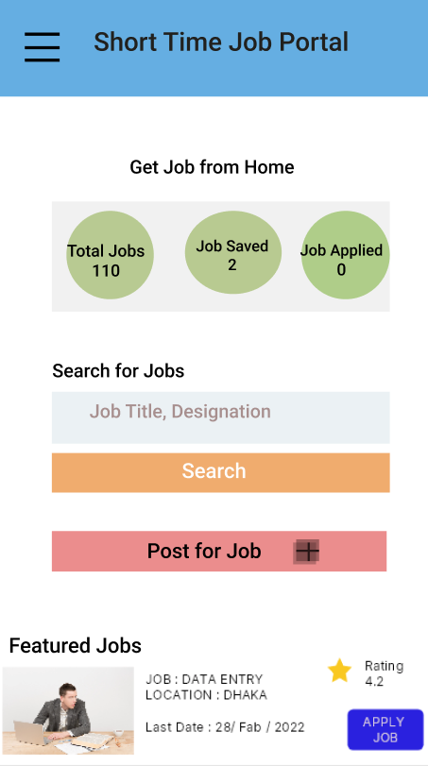
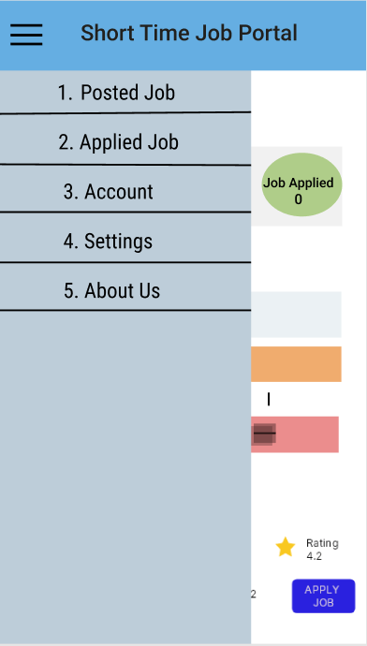
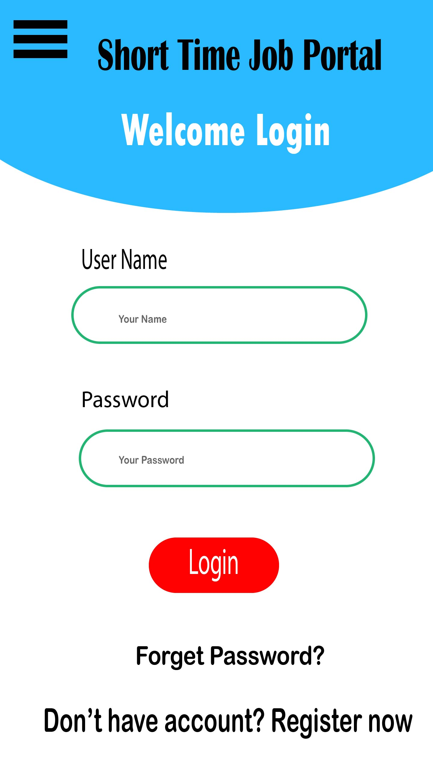
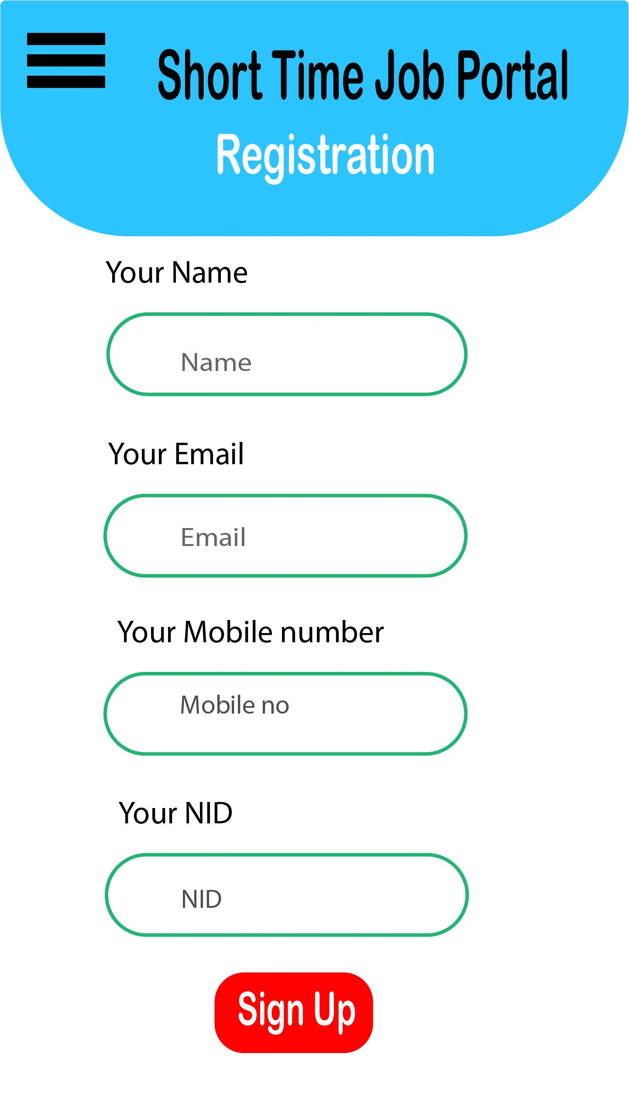
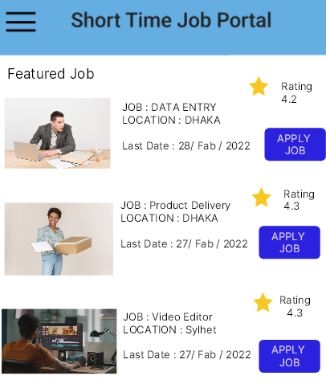
USER INTERFACE DESIGN

Slide 9
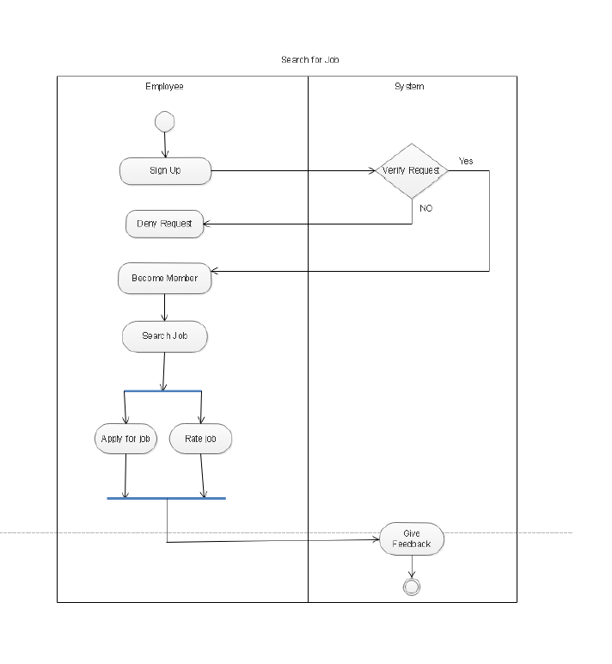
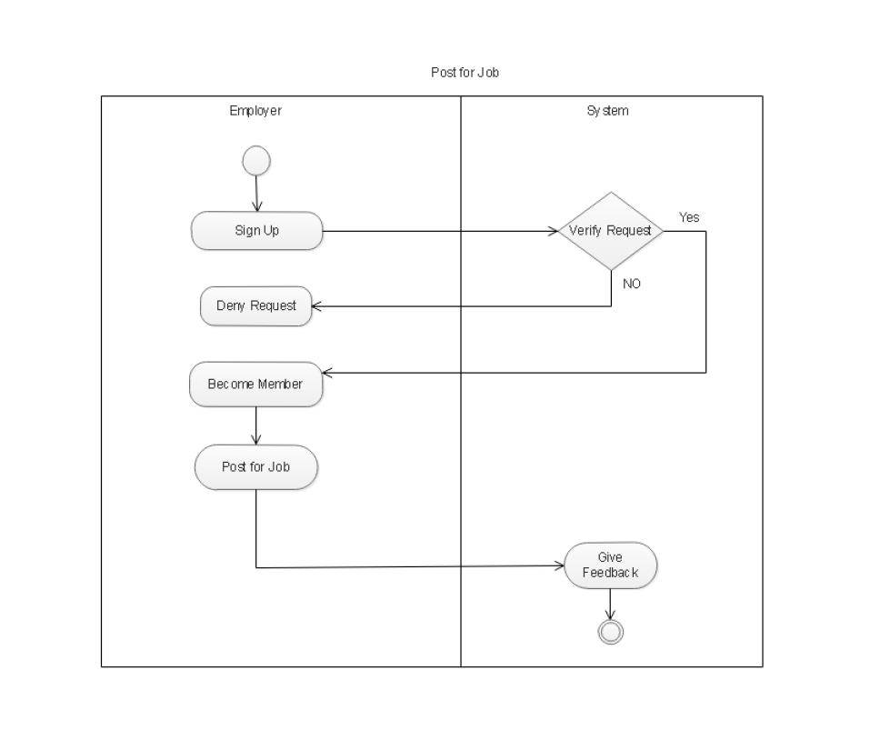
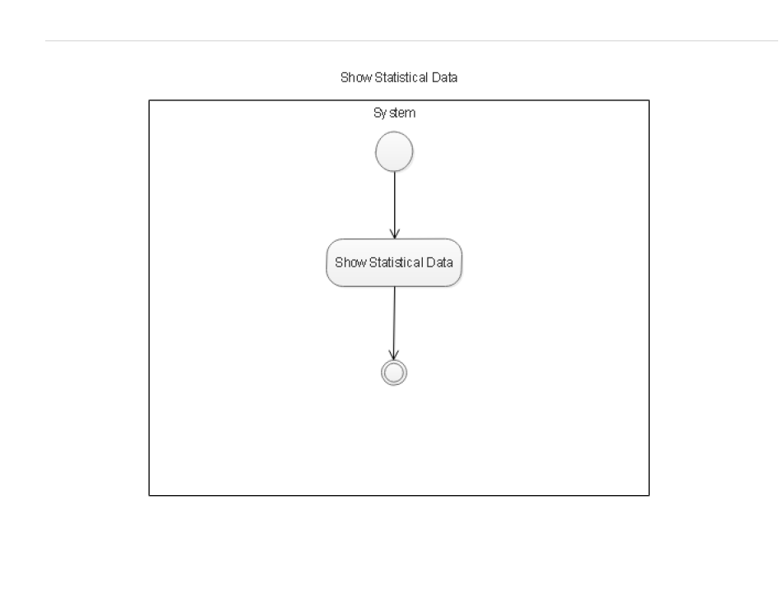
ACTIVITY DIAGRAM

Slide 10
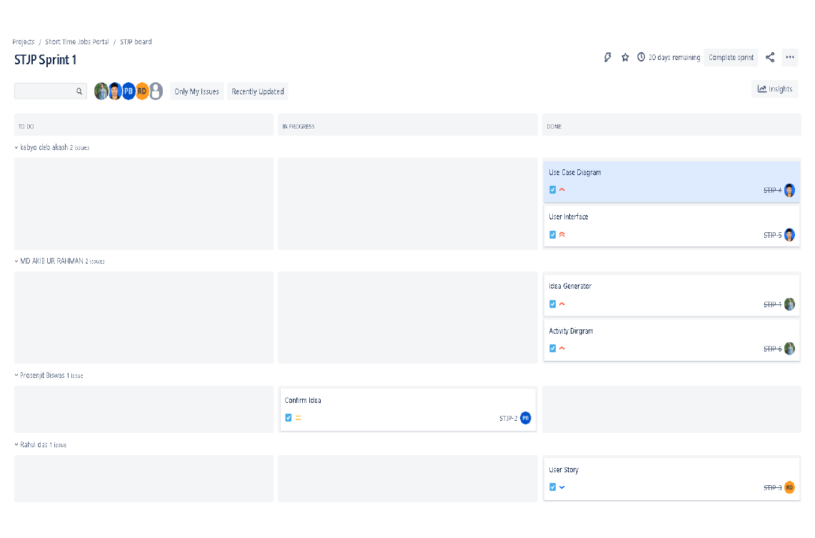
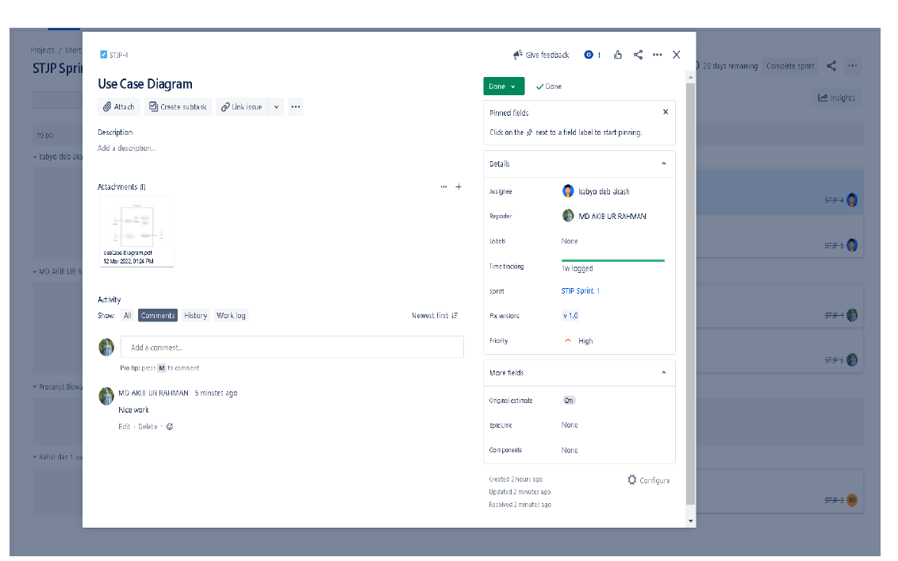
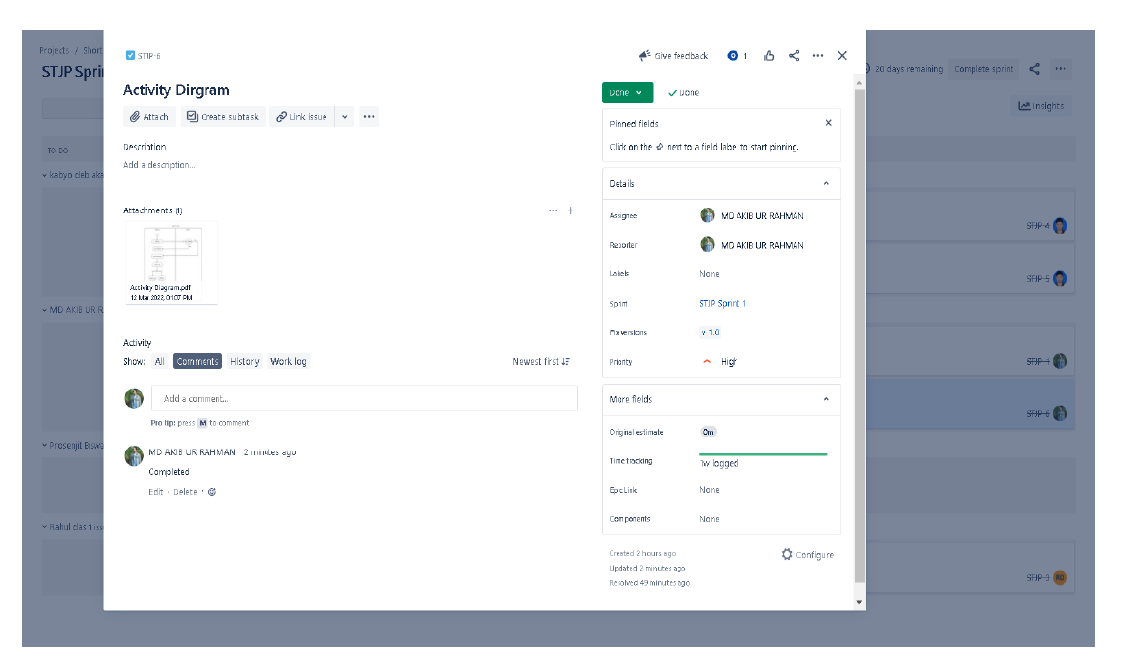
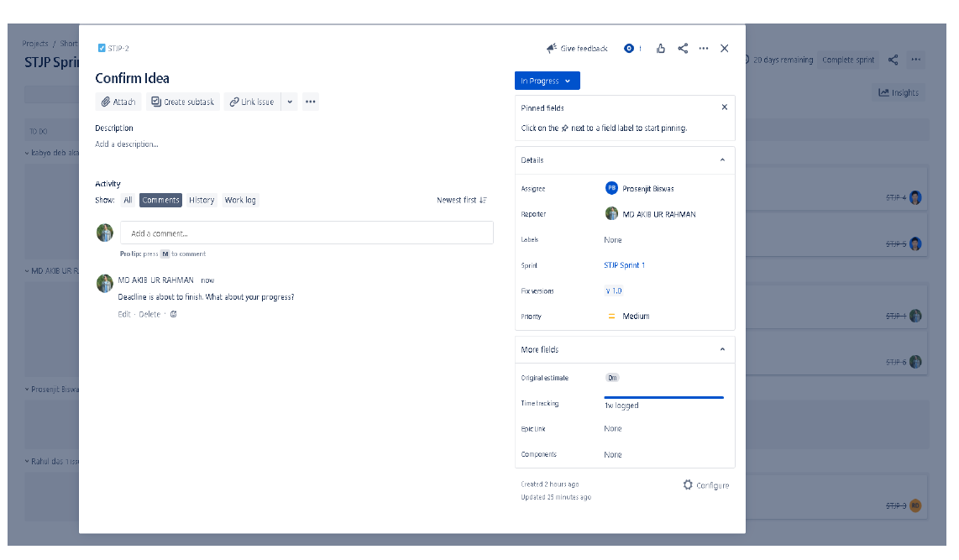
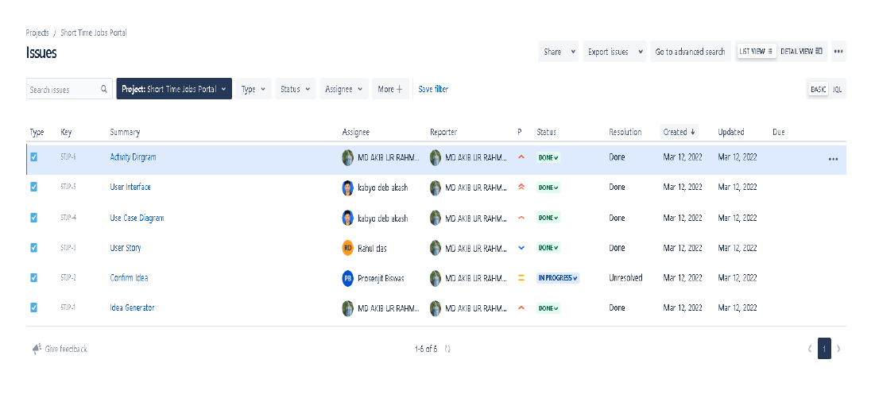
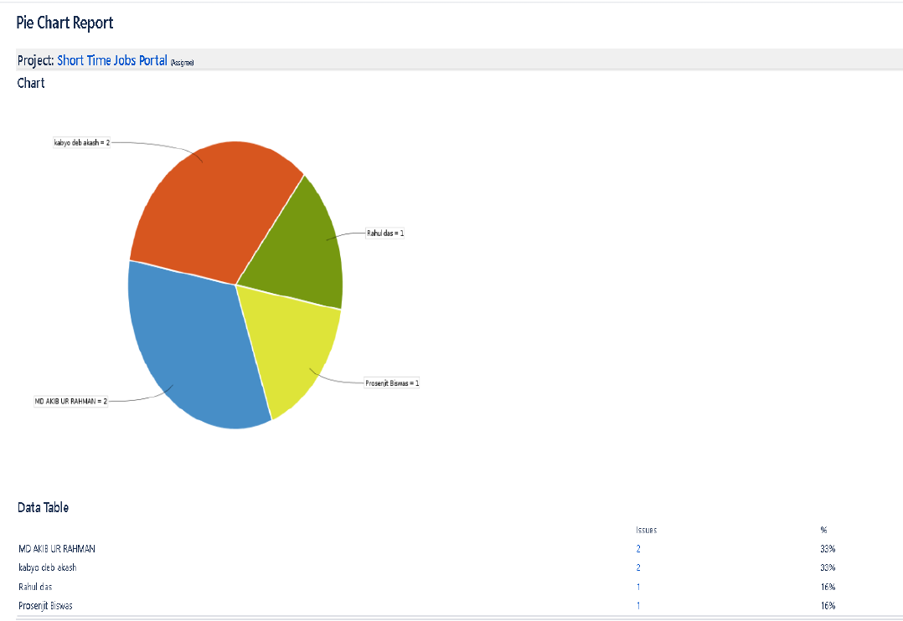
JIRA TOOLS

Slide 11
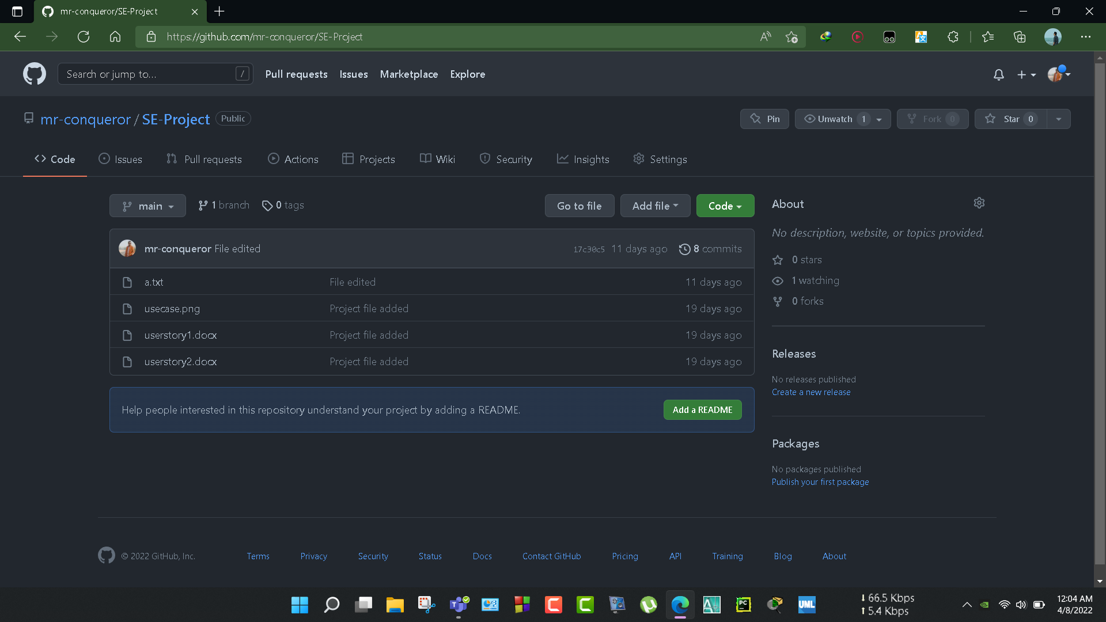
GITHUB TOOLS

Slide 12
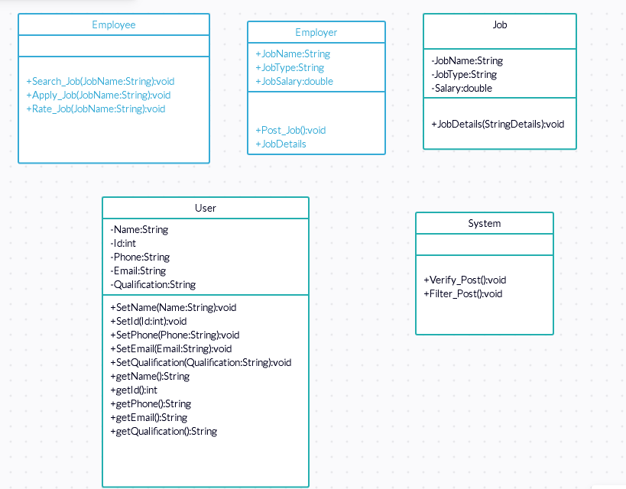
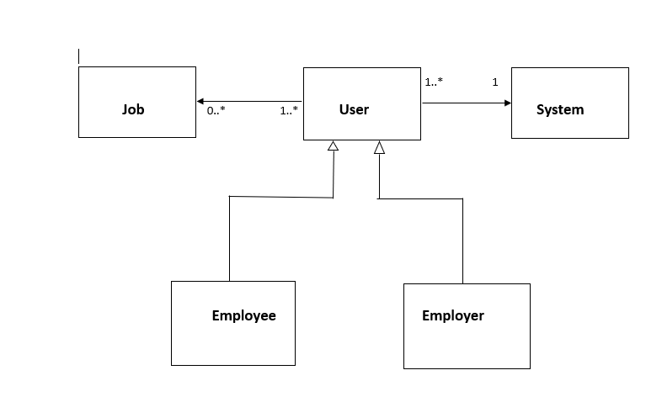
CLASS DIAGRAM

Slide 13
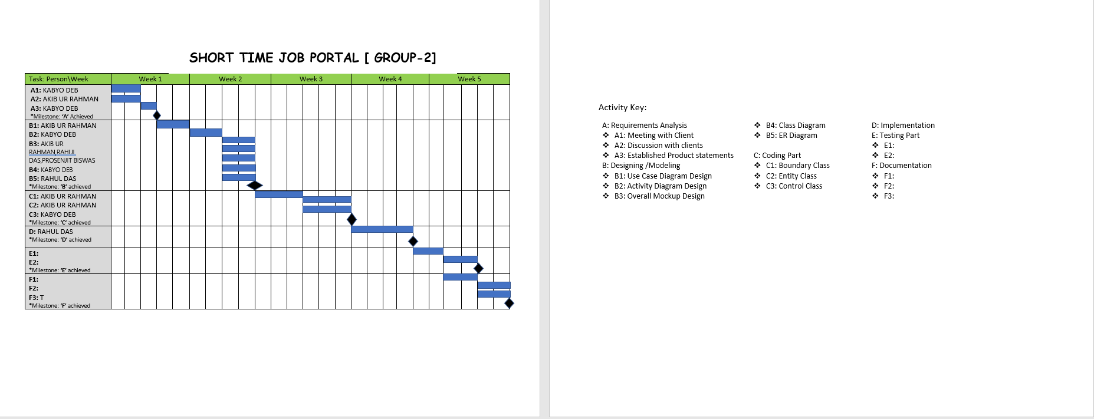
PROJECT SCEDULING

Slide 14
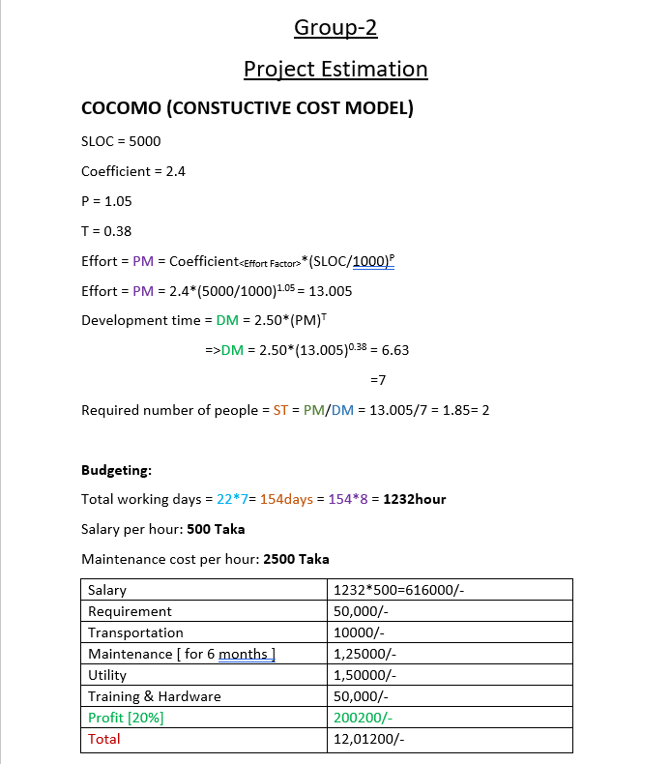
PROJECT BUDGETING

Slide 15

CONCLUSION
1.To Reduce The Unemployment Problem & Also To Generate Revenue From This Portal, The Project Has Been Selected
2.Before Starting The Development Part, Some UML Diagrams, Interface Design, Activity Diagram, Class Diagrams, ER Model, Project Scheduling & Budgeting Has Been Done
3.By Using Figma and Abode Photoshop the user interface has developed.
4.To Develop The Project Fluently JIRA & GIT Has Been Used

Slide 16


